Slide 1
Database Management Systems Sessional(CSE 2206) Project name : Hotel Management System
Bangladesh Army University of Science and Technology
Department of Computer Science and Engineering
Group Members: 1.Mousumi Monera Khatun (210201014) 2.Abir Hasan Imran (210201028) 3.Rayhan Sarkar Roman (210201036) 4.Fatema Tuj Zohora (210201039) | Project Supervisor: Hasan Muhammad Kafi Assistant professor Department of Computer Science and Engineering, BAUST

Slide 2
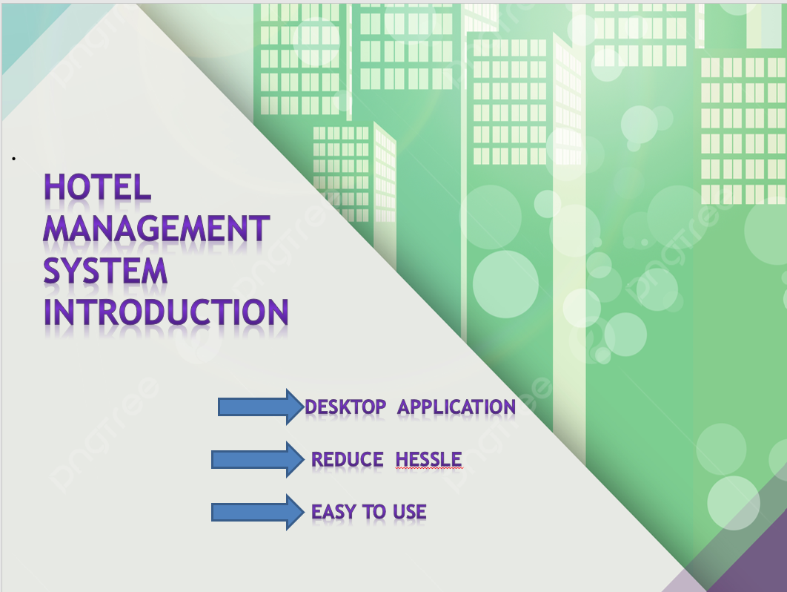

Slide 3
Objectives
Using My SQL Database to store data.
A option for customer to book hotel.
Better system to store current employee information.

Slide 4
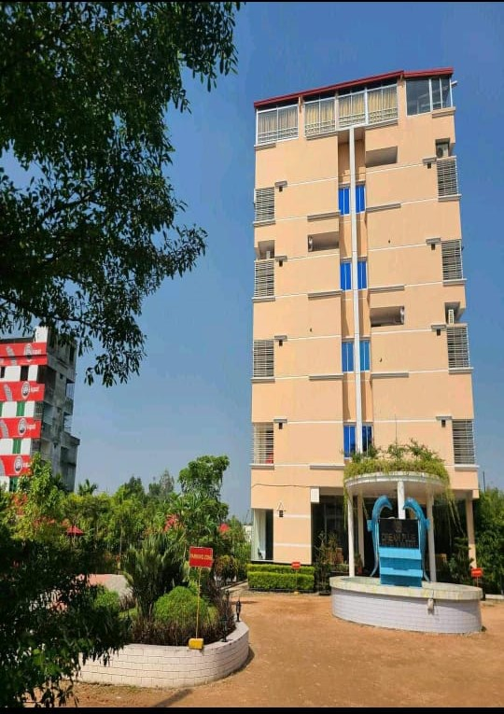
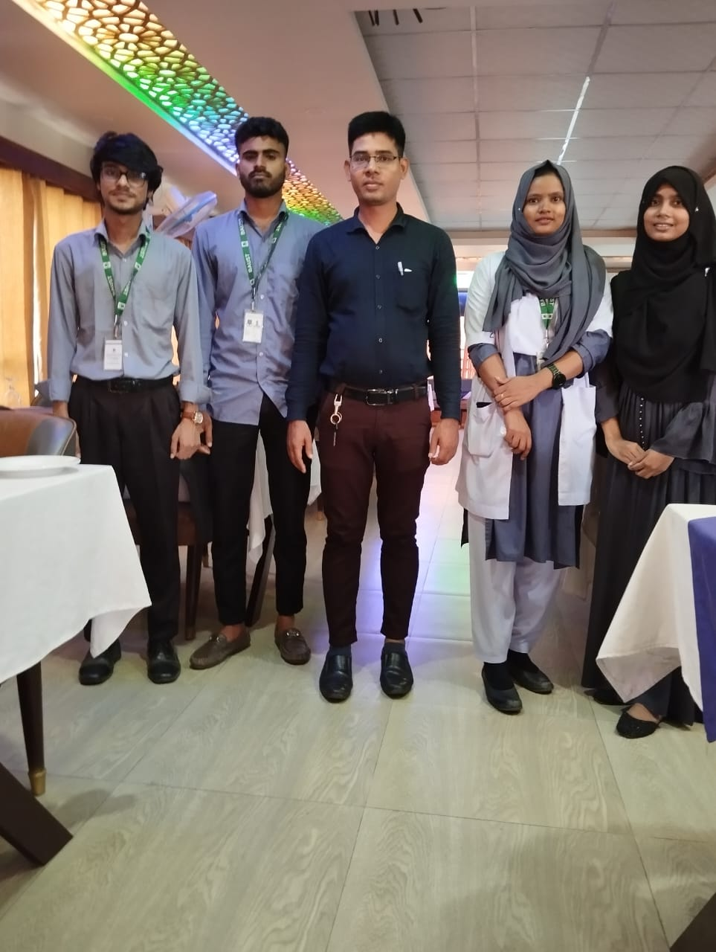
Visiting Dream plus hotel and resort

Slide 5
Problem definition:
Room management.
Reservation management.
Check-in and check-out.
Billing and payments.
Calculate profit.

Slide 6
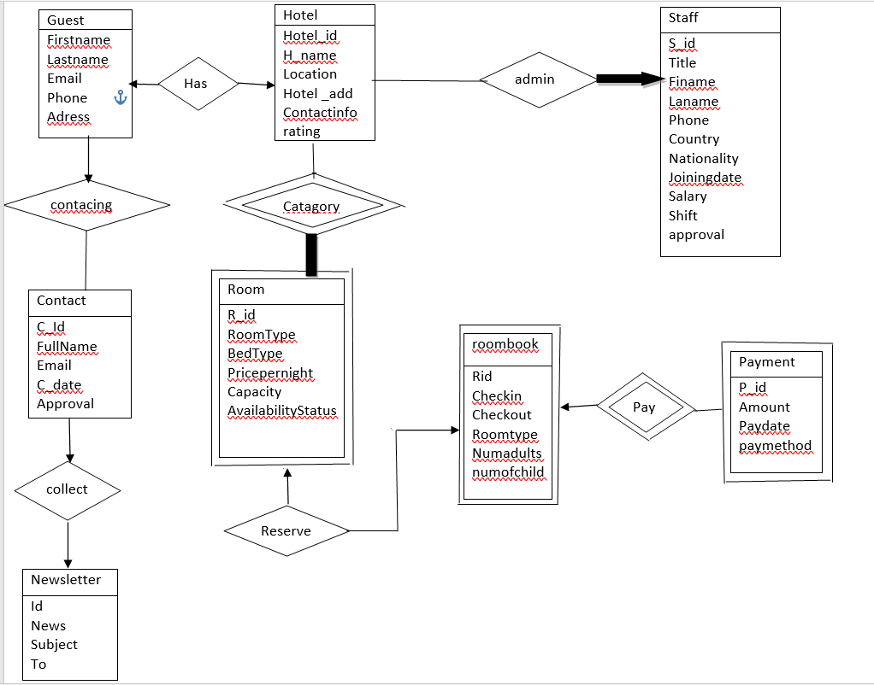
Er-diagram for hotel management system

Slide 7
Methodology
Collect require data
Creating database
Implementation
Testing
Deployment

Slide 8
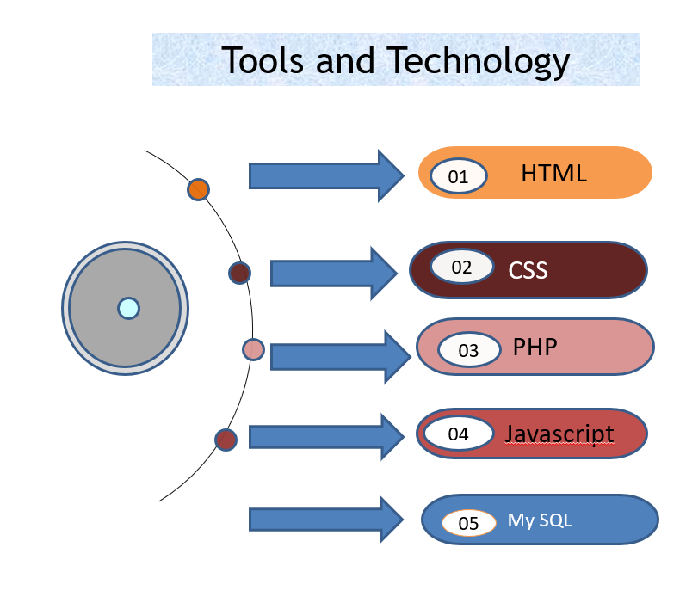

Slide 9
.
Modules:
Home
Rservation
Room Status
Add Room
Profit
Contact
Payment
Staff
Staff info

Slide 10
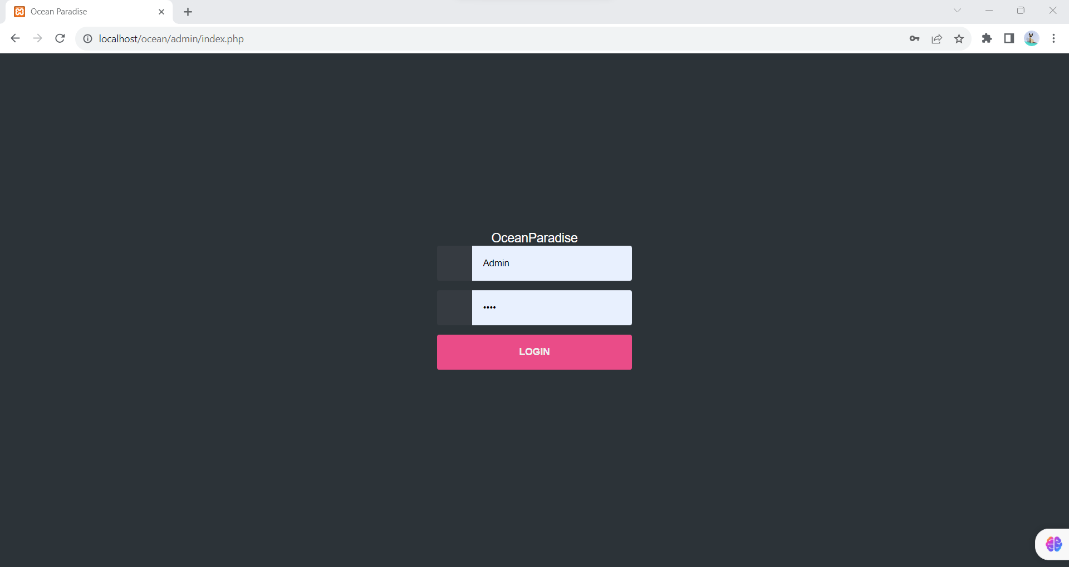
IMPLEMENTATION

Slide 11
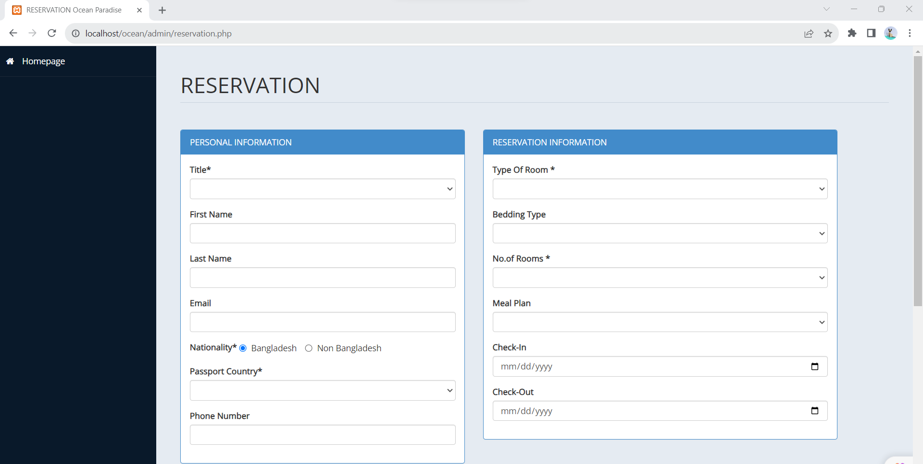
.
IMPLEMENTATION

Slide 12
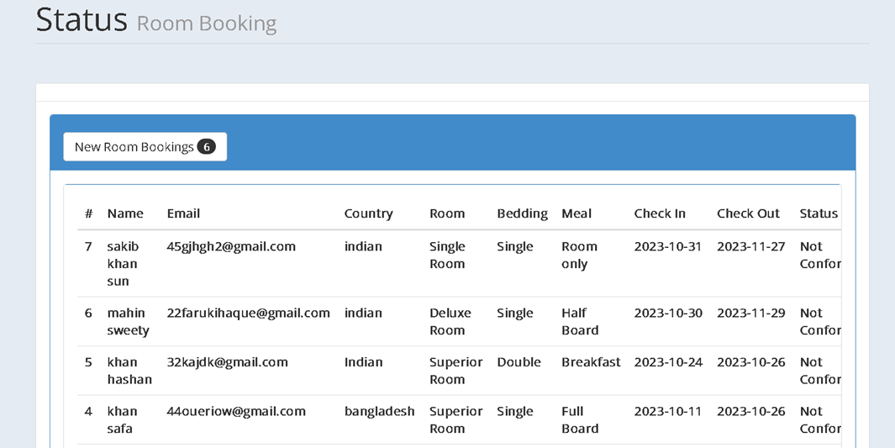
.
IMPLEMENTATION

Slide 13
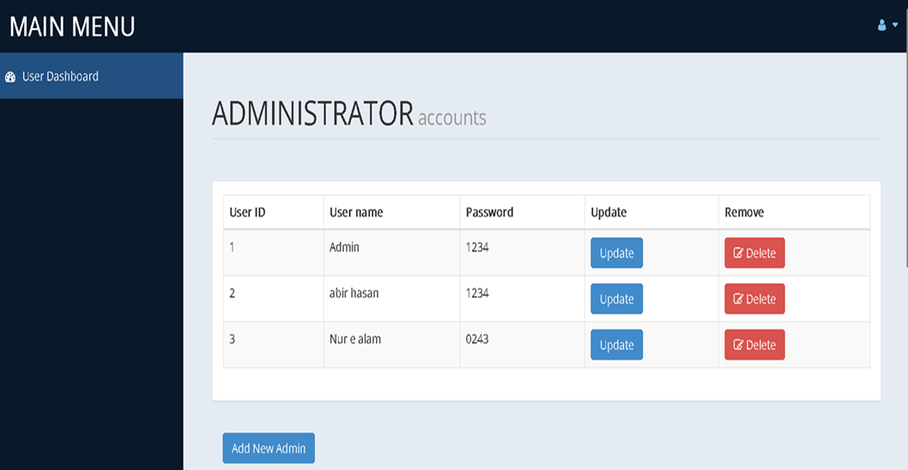
IMPLEMENTATION

Slide 14
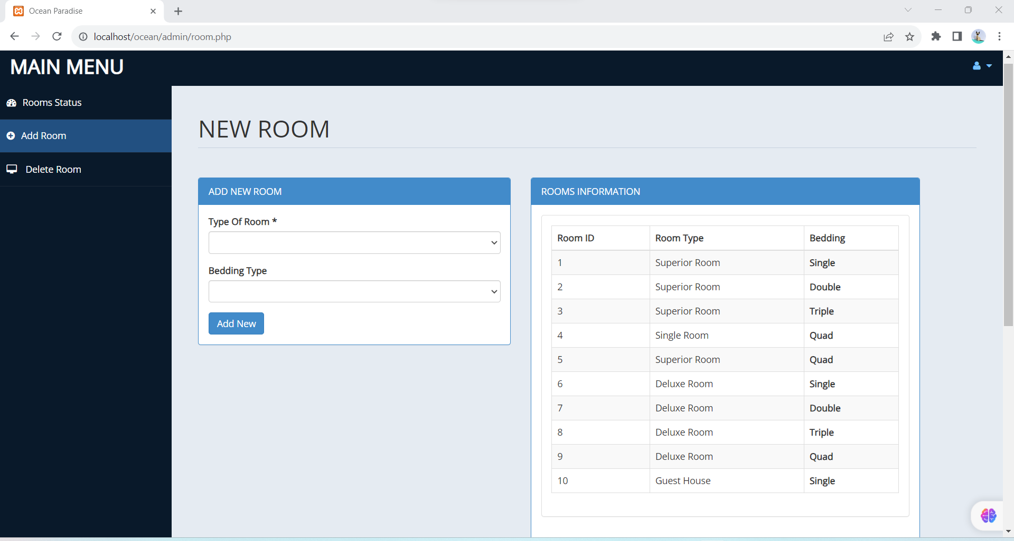
.
IMPLEMENTATION

Slide 15
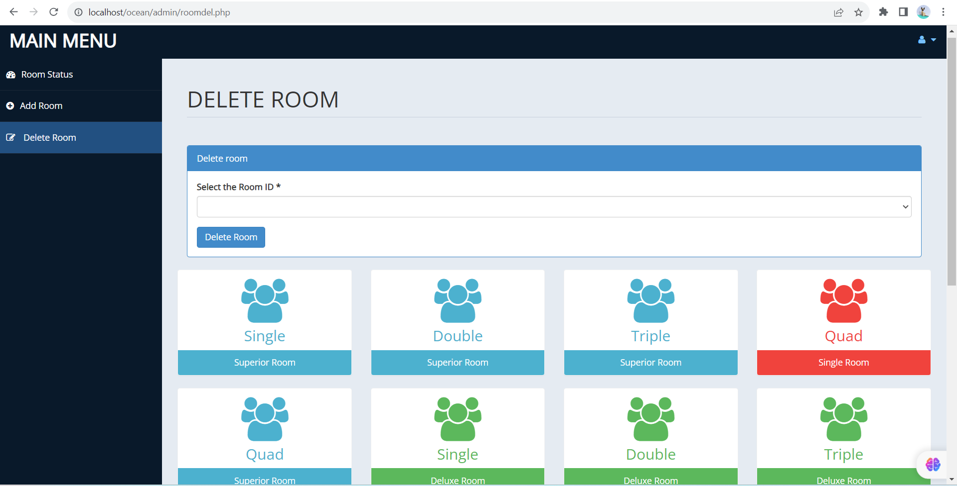
IMPLEMENTATION

Slide 16
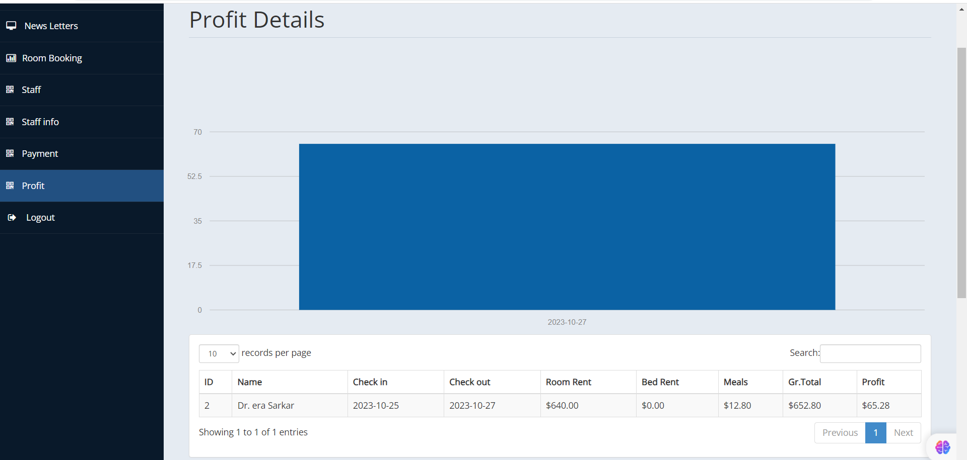
.
IMPLEMENTATION

Slide 17
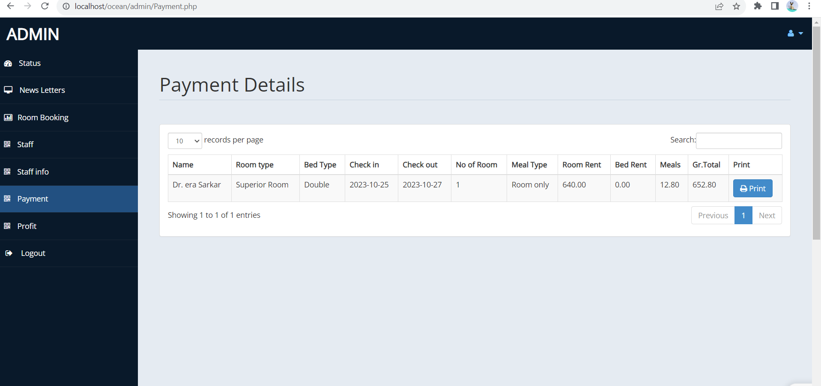
.
IMPLEMENTATION

Slide 18
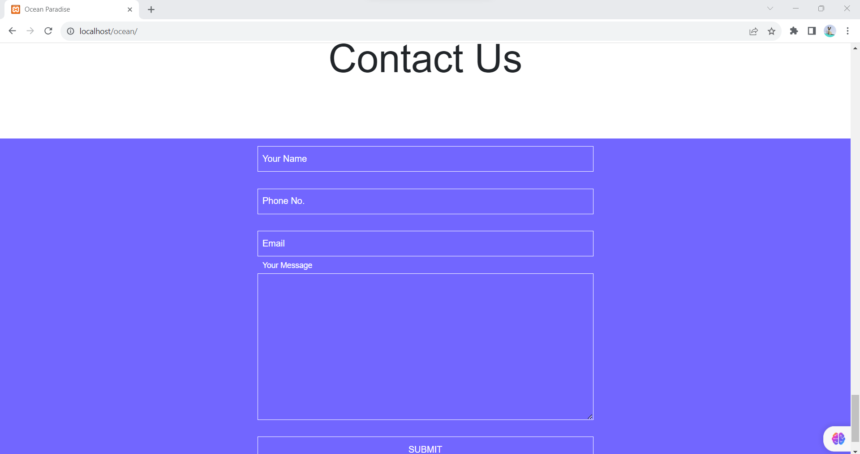
.
IMPLEMENTATION

Slide 19
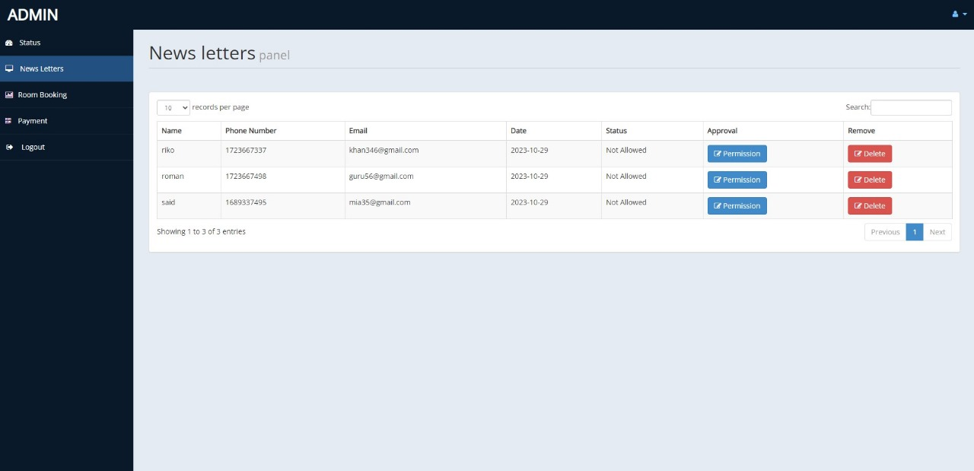
.
IMPLEMENTATION

Slide 20
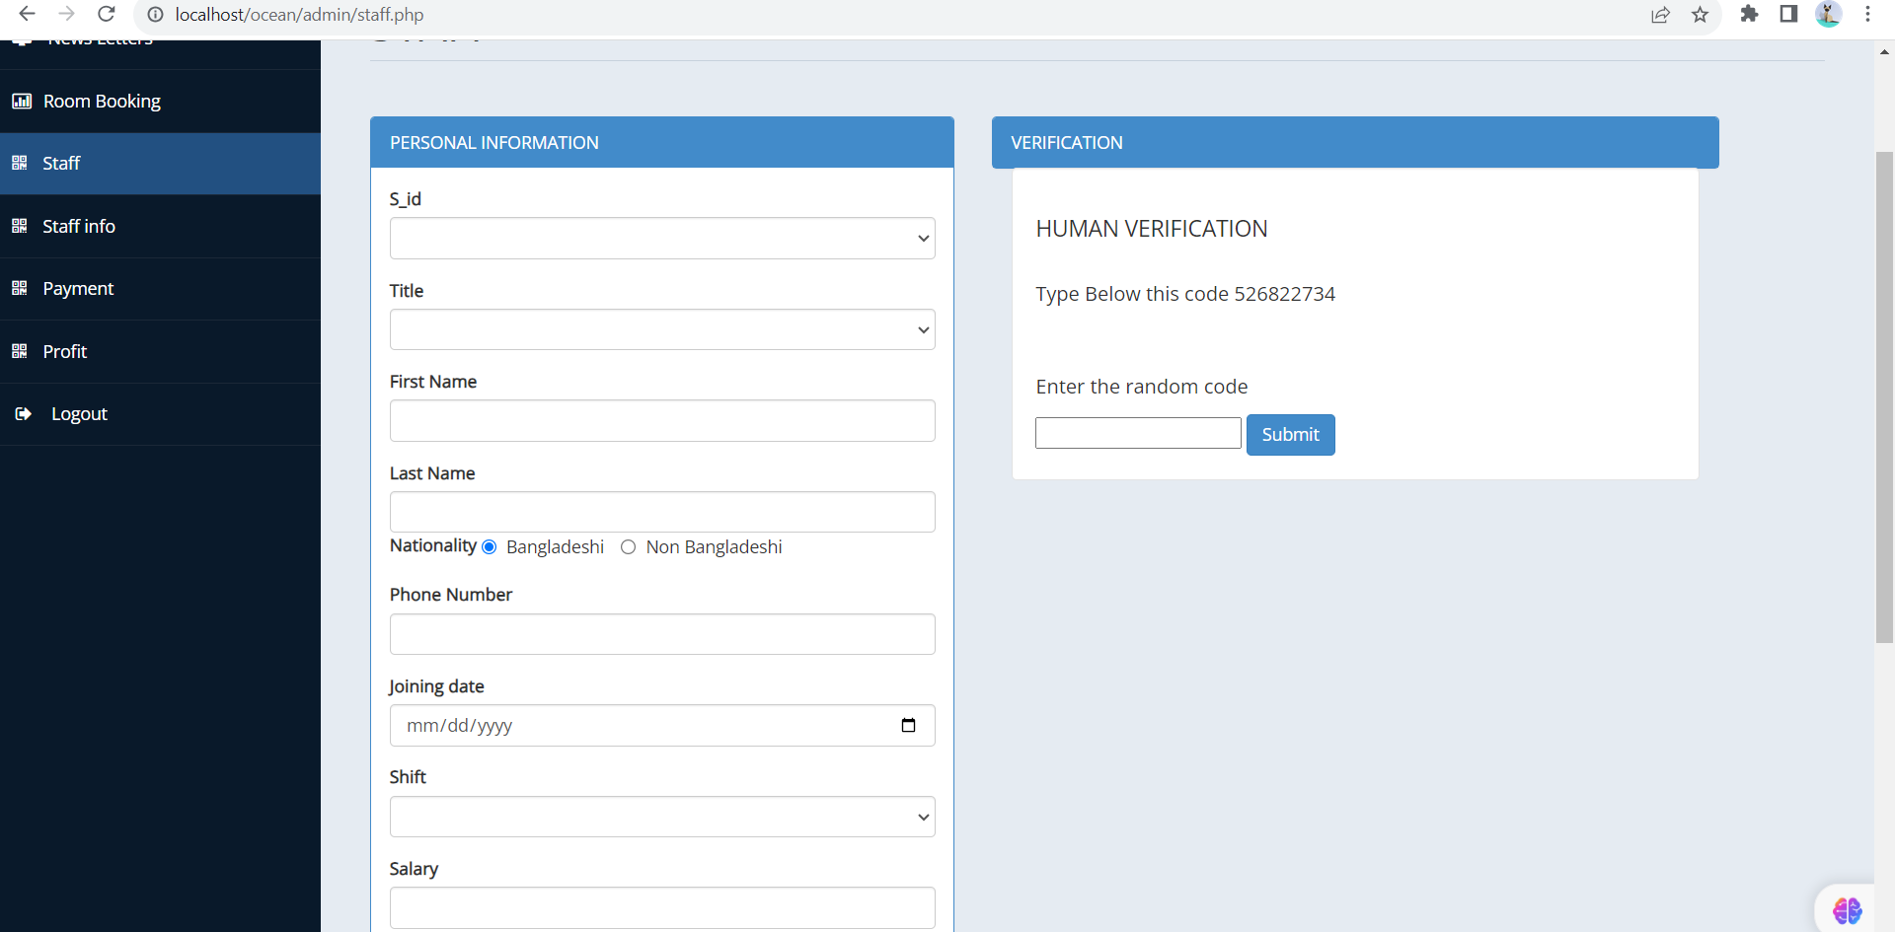
.
IMPLEMENTATION

Slide 21
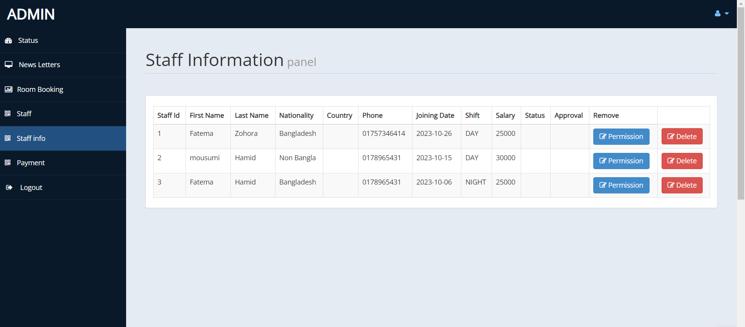
.
IMPLEMENTATION

Slide 22
Case study of old system
Goals of the new system
Physically attend need to book room.
Customer calls to manager for review.
Hard to are range in ledger.
Hard to know who is current employee.
Need to do big calculation manually
Review about hotel.
Managers manages room digitally.
Admins can see earning information.
Book Hotel from home.

Slide 23
Future scope
The rise of artificial intelligence (AI): AI is already being used in a variety of ways in the hospitality industry, and its use is only expected to grow in the future.
The increasing popularity of mobile devices: Guests are increasingly using mobile devices to book hotels, make reservations, and access information about their stay.
The growing demand for sustainability: Guests are becoming more and more concerned about sustainability, and hotels are under pressure to reduce their environmental impact

Slide 24
Benefits of this projects:
Streamlined Operations
Enhance Guest Experience
Improved communication
Better Financial management

Slide 25
Conclusion: The Conclusion of this project is a hotel management system is a computerized management systems. This system keeps the records of hardware assets besides software of the organization. The proposed system will keep a track of workers, residents,accounts generation of report regarding the present status.

Slide 26
Reference:
http://www.getbootstrap.com
http://www.getbootstrap.com
http://www.w3school.com/html
http://www.w3school.com/php
http://github.com
http://chat.openai.com

Slide 27


